Slide 1


Open data in your kitchen... and bathroom !
Pierre Slamich - pierre@openfoodfacts.org

Slide 2
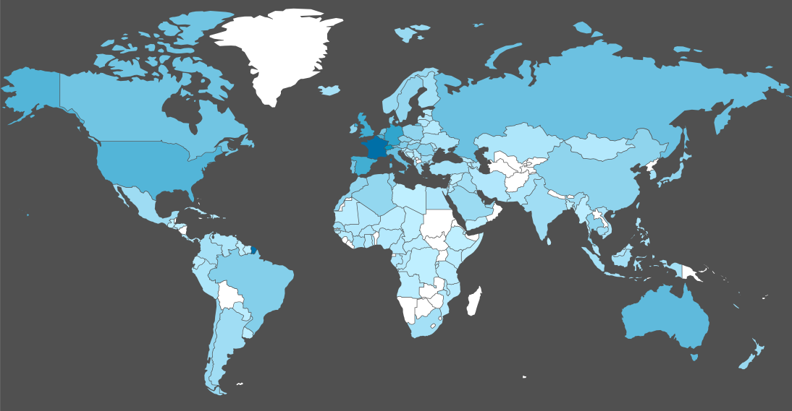
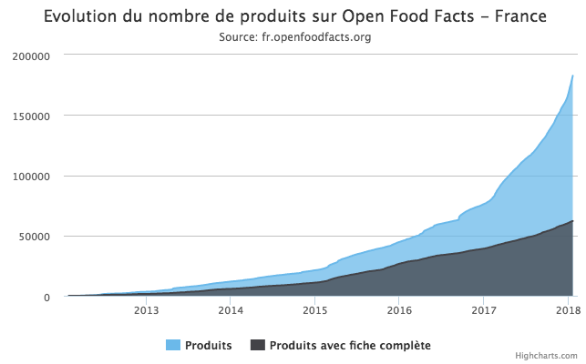
Open Food Facts - “the wikipedia of food”
Started 5 years ago
Strictly non-profit, and volunteer run
Works using very large scale mobile crowdsourcing
Almost 1/2 million food products already liberated
1K new products opened daily by 8K worldwide contributors
Around 2 million people rely directly or indirectly on us

Slide 3
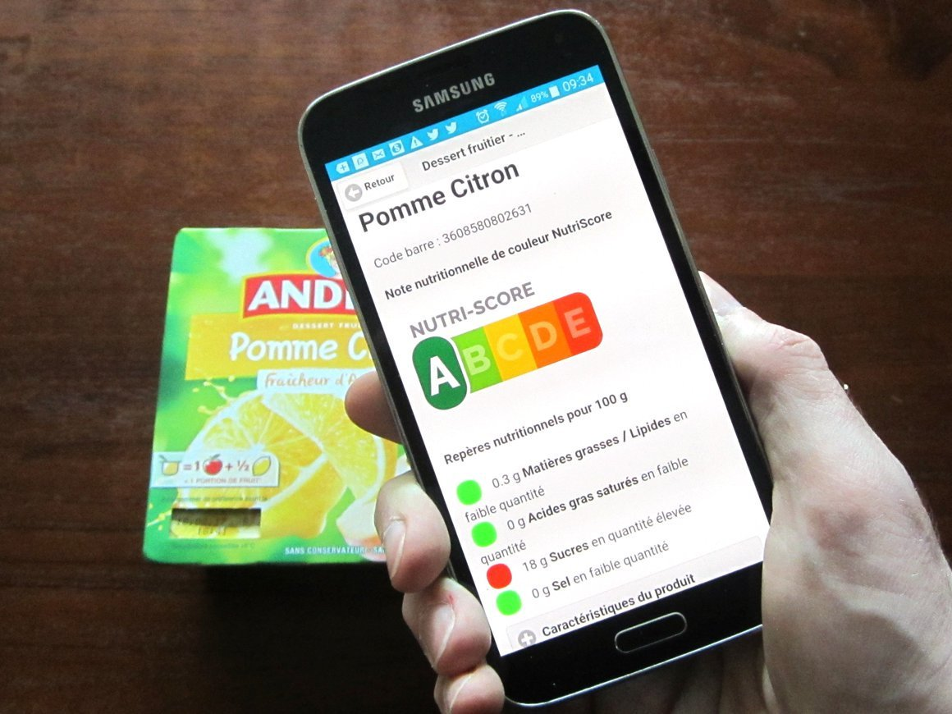

Slide 4
Making the cosmetics industry more transparent, thanks to
open data and crowdsourcing

Slide 5
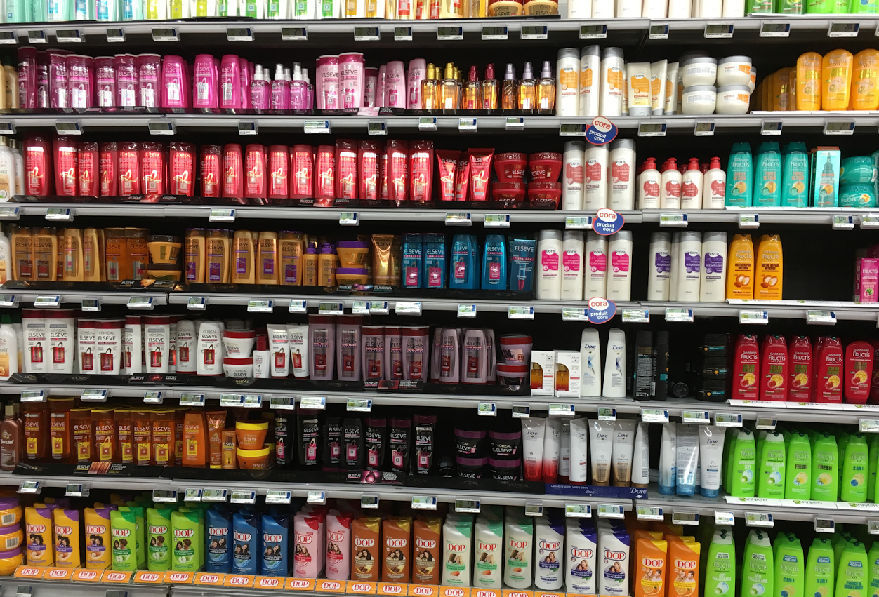
How much data do you actually use?

Slide 6
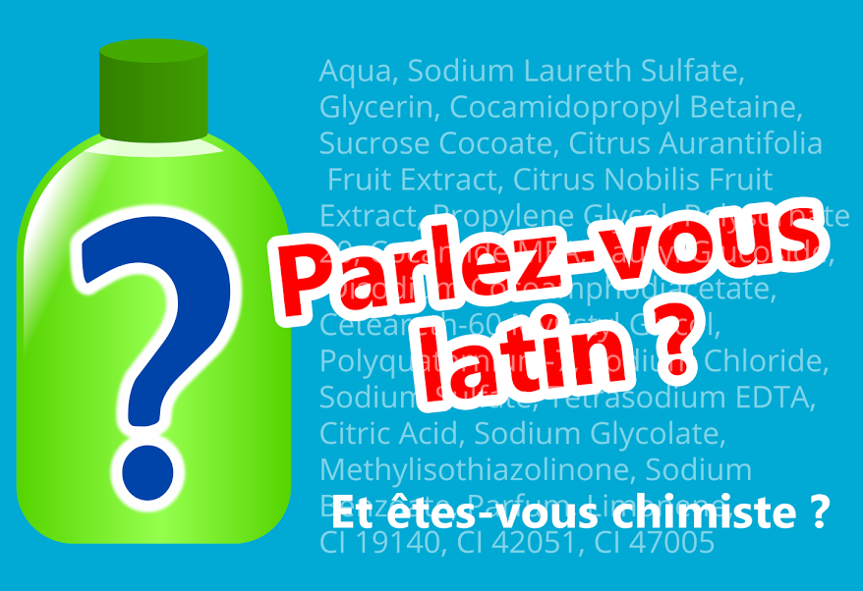
Cosmetics are all greek, english and latin to us.

Slide 7



Can we open the data on
cosmetic products ourselves?
The Free Wiki World Map
and ?

Slide 8
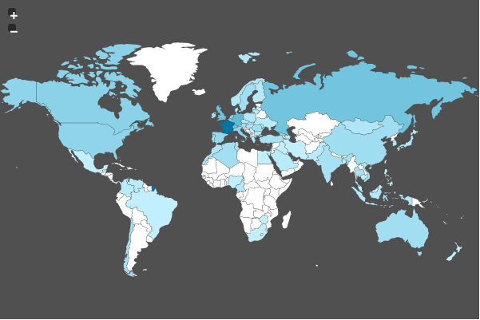
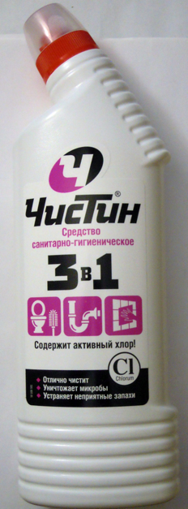
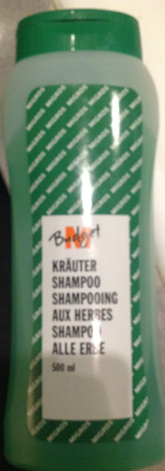
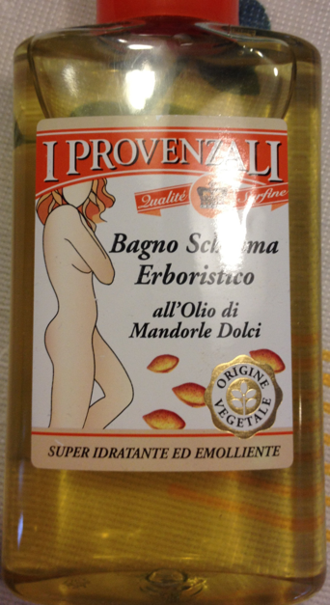
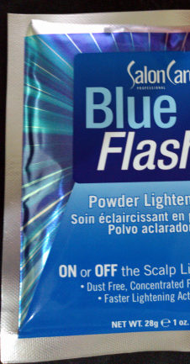
A database of cosmetics products from around the world
Cosmetics & Cleaning products from 80 countries so far…
5300+ products, and many more to come
270+ contributors

Slide 9
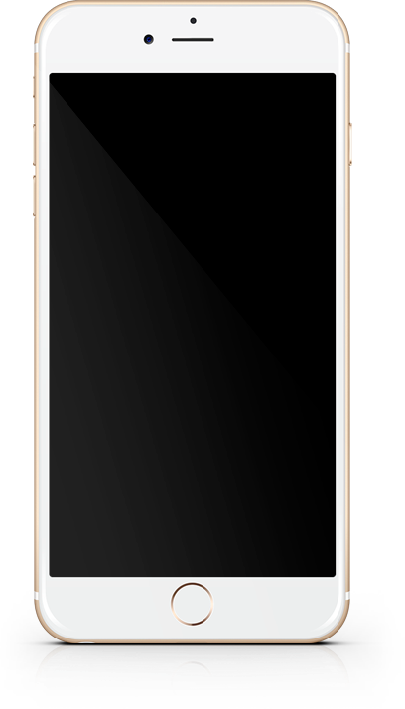
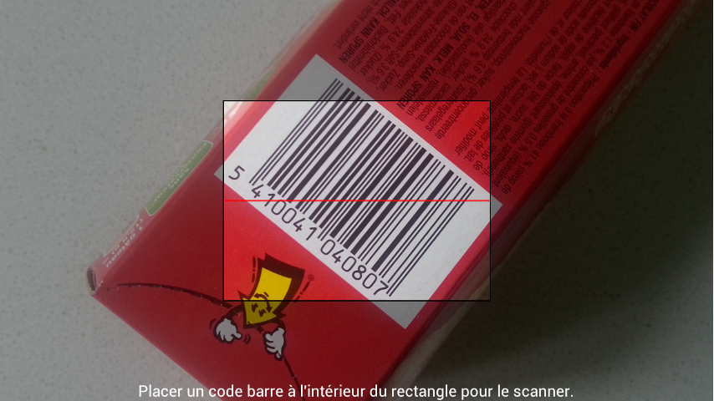
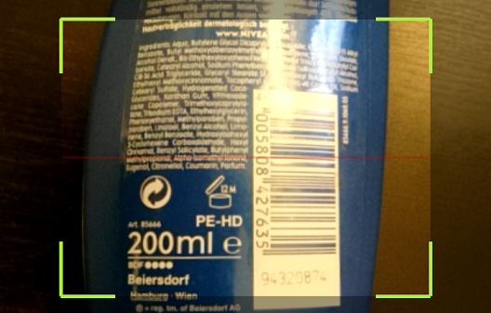
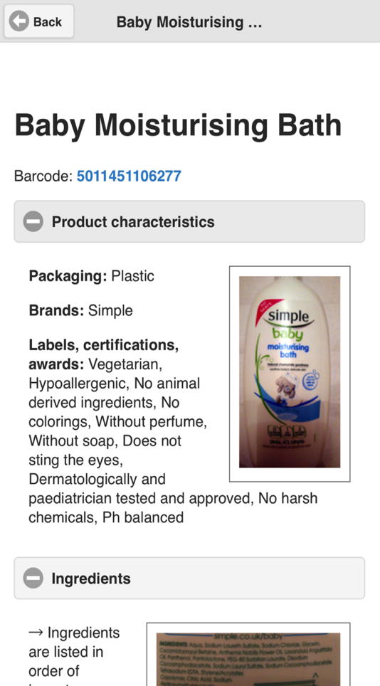


Scan products, get informed, contribute
Crowdsourcing
(Web, Android, iOS, Windows Phone)
Open Database Licence (ODbL)

Slide 10
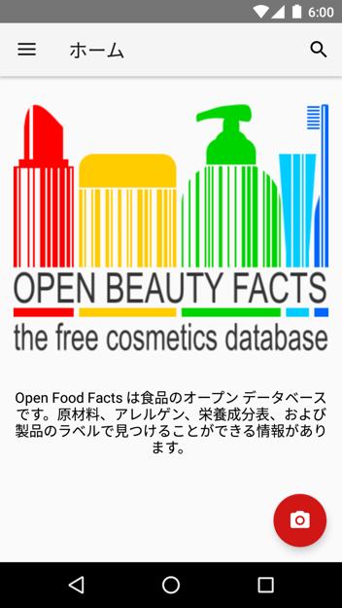
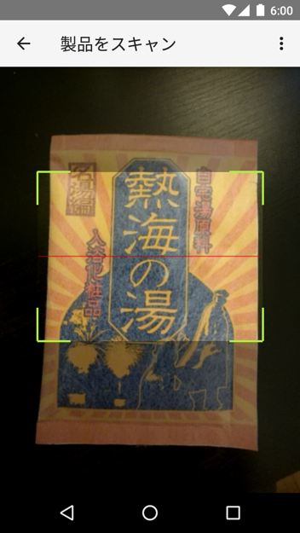
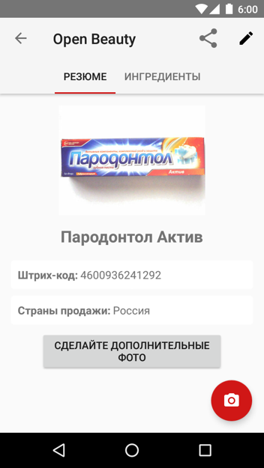
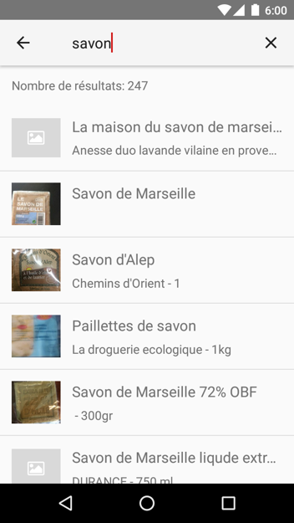
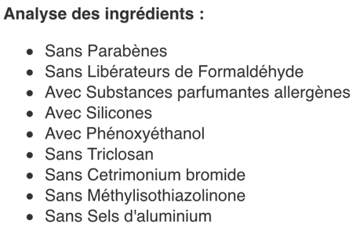
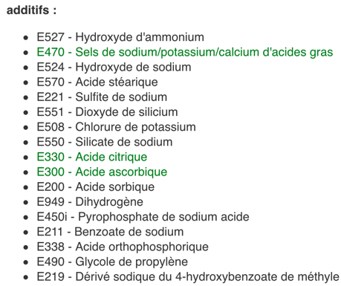
Substance detector
Allergizing substances according to the EU
Harmful substances according to UFC Que Choisir (based on scientific consensus)
All additives

Slide 11
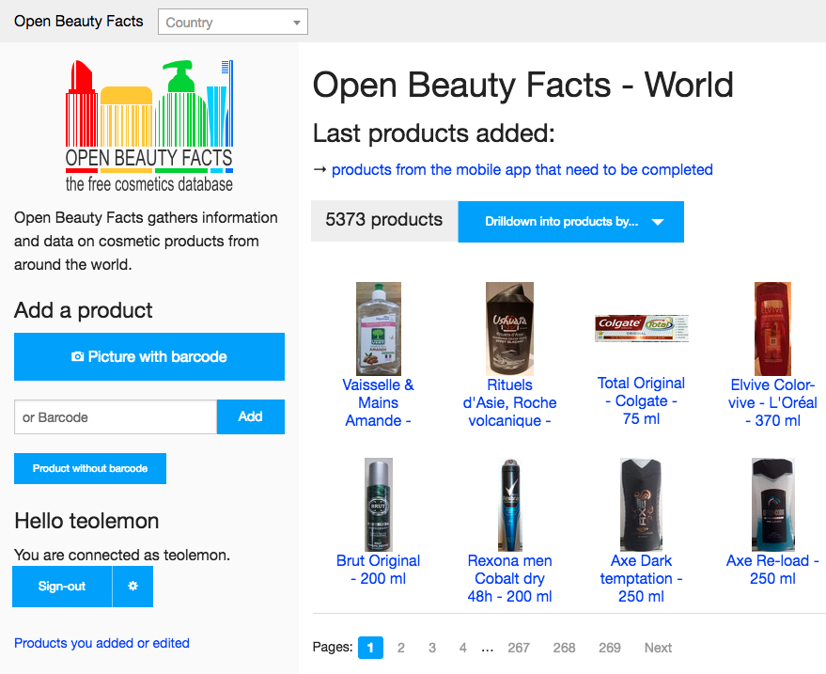
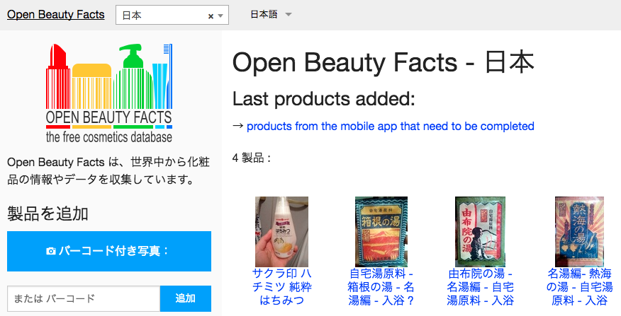
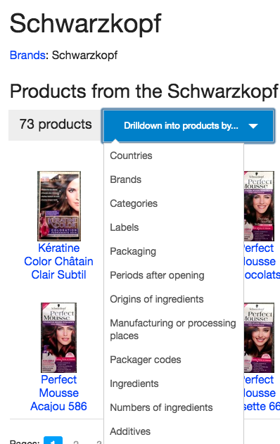
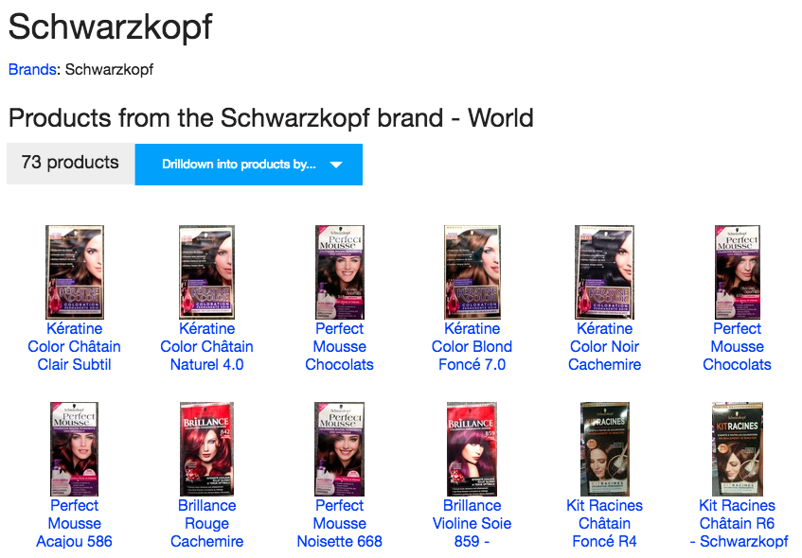

Slide 12
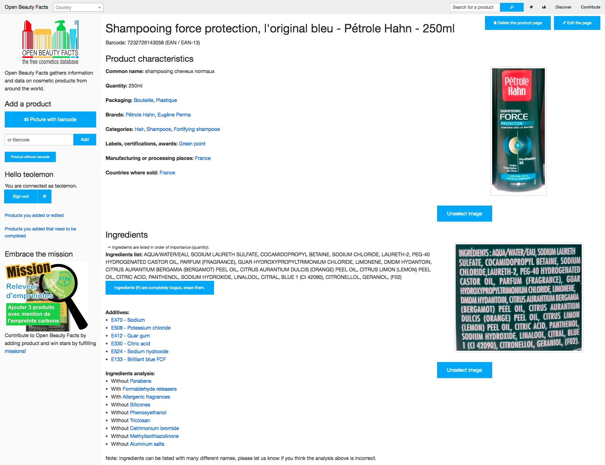

Slide 13
What can we do with that data ?

Slide 14

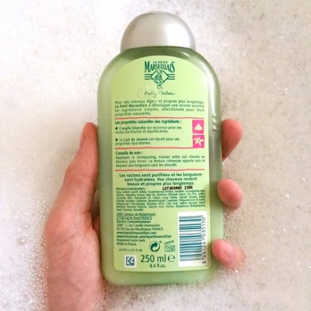
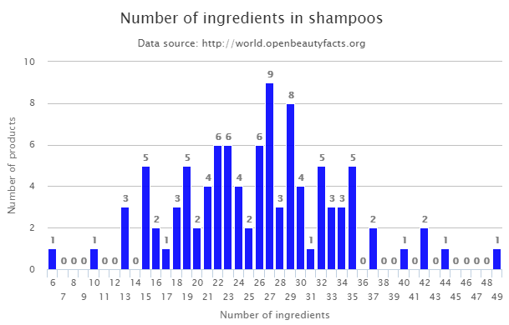
Compare products
https://world.openbeautyfacts.org/cgi/search.pl?action=process&tagtype_0=categories&tag_contains_0=contains&tag_0=shampoos&sort_by=unique_scans_n&page_size=20&axis_x=ingredients_n&axis_y=products_n&graph_title=Number%20of%20ingredients%20in%20shampoos&graph=1

Slide 15
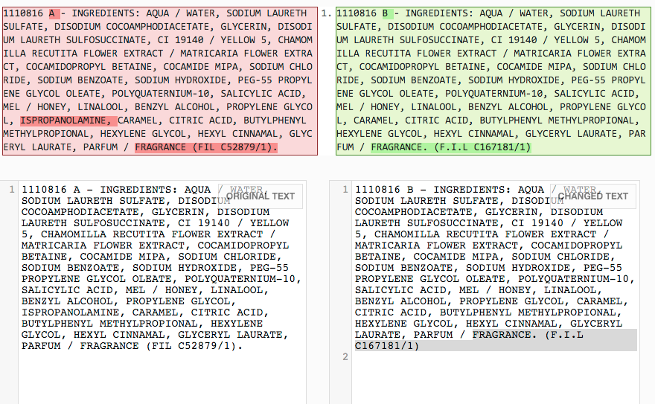
Track changes across time
& geographies

Slide 16
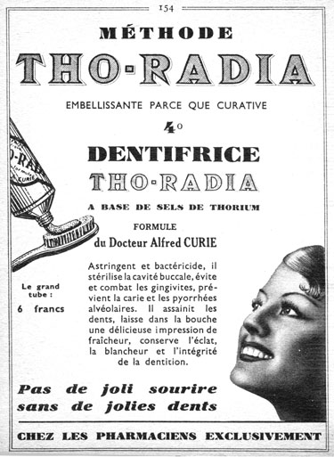
Cosmetic Archeology
Radium-based
cosmetic products

Slide 17

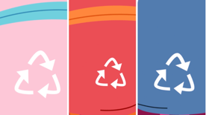
Smart packaging initiatives needs to be open to succeed
Get the recycling information in every consumer’s hands, regardless of the device, application, or IOT object they are using
Enable smart-sorting based on barcodes, NFC, visual recognition

Slide 18
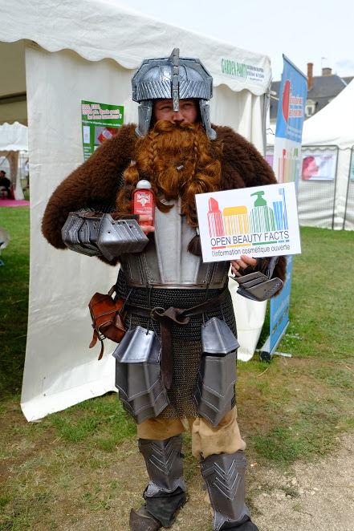
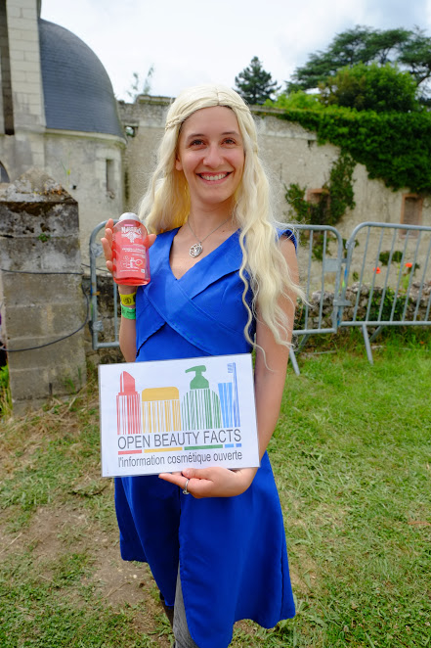
They also care about Cosmetic Transparency ☺

Slide 19







Making the cosmetic industry more
transparent and more open ?
Join us!

Slide 20
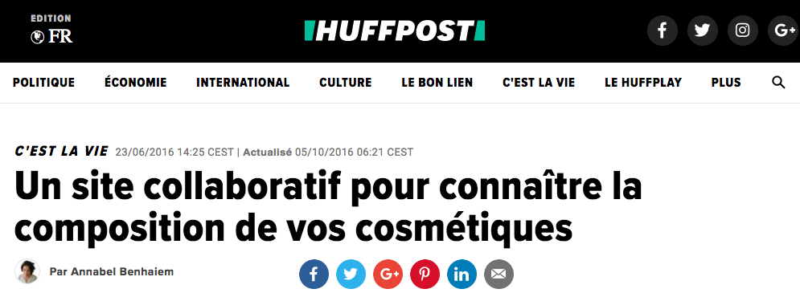

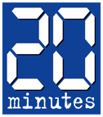
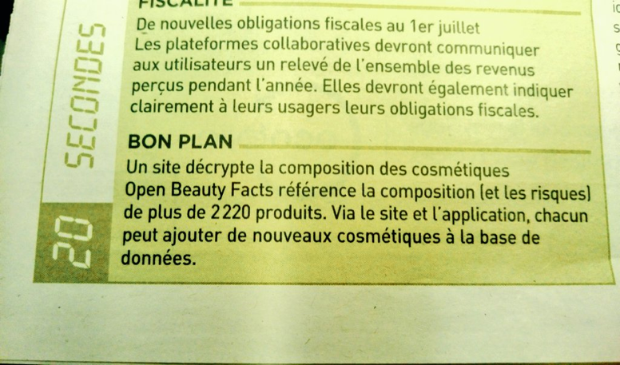
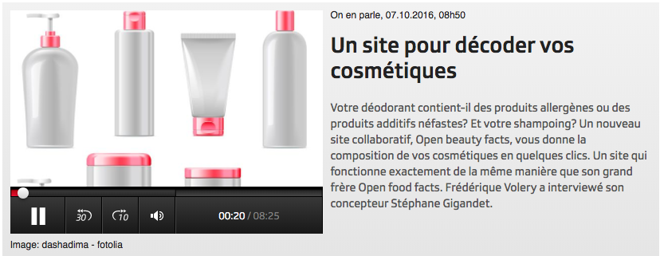
Open Beauty Facts already in the media
BEAUTÉ - Vous n'achèterez plus vos produits cosmétiques aveuglément. Le site Open beauty facts rend leur composition facile à lire et à comprendre. C'est un must quand on sait qu'il faut un doctorat de chimie pour déchiffrer les étiquettes.

Slide 21
How does it work ?

Slide 22
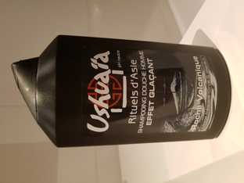
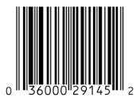
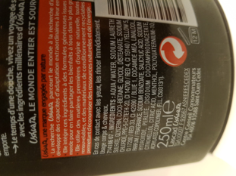
1.Users scan products and take pictures of them

Slide 23
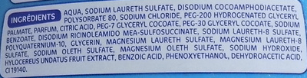
2. An automatic OCR is performed as a 1st step
AQUA, SODIUM LEURETH SULFATE, DISODIUM COCOAMPHODIACETATE, POLYSORBATE 50, SODIUM CHLORIDE, PEG-200 HYDROGENATED GLYCERYL PALMATE, PARFUM, CITRIC ACID, PEG-7 GLYCERYL COCOATE, PEG-30 GLYCERYL COCOATE, SODIUM BENZOATE, DISODIUM RICINOLEAMIDO MEO-SULFOSUCCINATE, SODIUM LAURETH-8 SULFATE, POAQUA, SODIUM LEURETH SULFATE, DISODIUM COCOAMPHODIACETATELYQUATERNIUM-10, GLYCERIN, MAGNESIUM LAURETH SULFATE, MAGNESIUM LAURETH-8 SULFATE, SODIUM OLETH SULFATE, MAGNESIUM OLETH SULFATE, SODIUM HYDROXIDE, HYLOCEREUS UNDATUS FRUIT EXTRACT, BENZOIC ACID, PHENOXYETHANOL, DEHYDROACETIC ACID, CI 19140.

Slide 24
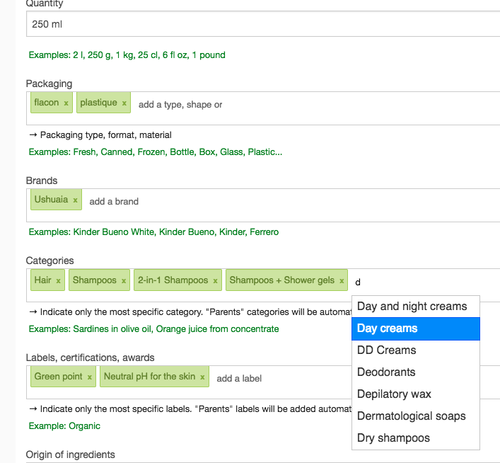
3. The data is collaboratively edited and checked
by the Open Beauty Facts community

Slide 25
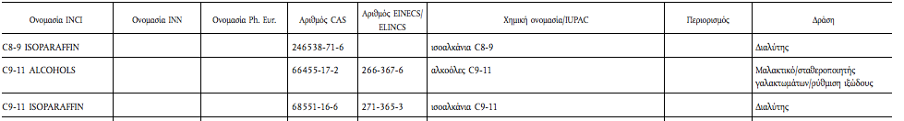
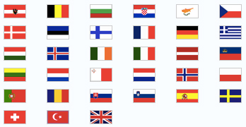
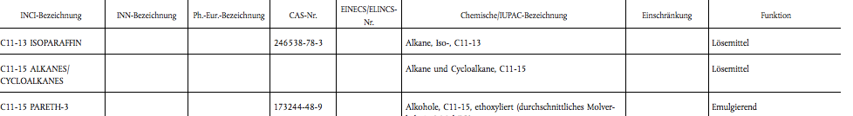
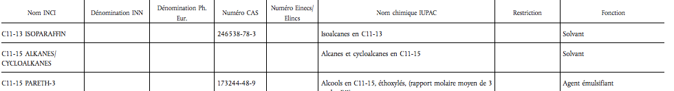
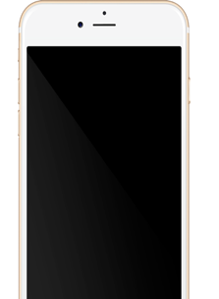

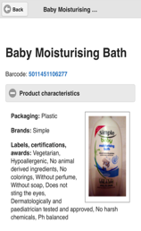
4. It is then deciphered automatically.
AQUA, SODIUM LEURETH SULFATE, DISODIUM COCOAMPHODIACETATE, POLYSORBATE 50, SODIUM CHLORIDE, PEG-200 HYDROGENATED GLYCERYL PALMATE, PARFUM, CITRIC ACID, PEG-7 GLYCERYL COCOATE, PEG-30 GLYCERYL COCOATE, SODIUM BENZOATE, DISODIUM RICINOLEAMIDO MEO-SULFOSUCCINATE, SODIUM LAURETH-8 SULFATE, POAQUA, SODIUM LEURETH SULFATE, DISODIUM COCOAMPHODIACETATELYQUATERNIUM-10, GLYCERIN, MAGNESIUM LAURETH SULFATE, MAGNESIUM LAURETH-8 SULFATE, SODIUM OLETH SULFATE, MAGNESIUM OLETH SULFATE, SODIUM HYDROXIDE, HYLOCEREUS UNDATUS FRUIT EXTRACT, BENZOIC ACID, PHENOXYETHANOL, DEHYDROACETIC ACID, CI 19140.

